Slide 1

Understanding Income Demographics and Academic Performance in Chicago Schools (SY16-17)
Sam Strickler
Introduction to Data Science – Final Project

Slide 2

Dataset Overview & Structure
Data provided by Chicago Public Schools.
Collected from data.cityofchicago.org.
Comprehensive school profile information for the Chicago Public School (CPS) district.
Covers the 2016-2017 school year.
Includes data for 661 schools in the district.
The dataset contains 661 rows accounting for each school individually.
There are 91 variables, capturing diverse aspects of each school. Some are precalculated statistics.

Slide 3

Variables Overview (1/2)
Key Categories of Variables
1. School Identification and General Information:
Variables: School_ID, Short_Name, Long_Name, School_Type, Primary_Category, Address, etc.
Purpose: Provides unique identifiers and general details about the schools, such as their names, types (e.g., Elementary, High School), and locations.
2. Enrollment and Demographic Details:
Variables: Student_Count_Total, Student_Count_Low_Income, Student_Count_Special_Ed, Student_Count_Black, Student_Count_Hispanic, etc.
Purpose: Captures the size and composition of the student body, including ethnic and socioeconomic breakdowns.
3. Academic Performance:
Variables: Mean_ACT, Average_ACT_School, Graduation_Rate_School, College_Enrollment_Rate_School, etc.
Purpose: Provides data on key performance metrics, such as test scores, graduation rates, and college enrollment percentages.

Slide 4
Variables Overview (2/2)
4. Facilities and Accessibility:
Variables: ADA_Accessible, Transportation_Bus, Transportation_El, School_Latitude, School_Longitude, etc.
Purpose: Describes the physical and logistical accessibility of the schools.
5. Administrative and Contact Information:
Variables: Administrator, Administrator_Title, Phone, Email, Website, etc.
Purpose: Details the administrative leadership and contact information for the schools.
6. Miscellaneous:
Variables: Overall_Rating, Rating_Statement, CPS_School_Profile, Statistics_Description, etc.
Purpose: Provides school ratings and descriptive summaries for basic insights.

Slide 5


Research Questions
Main
Side
Is there a relationship between a low-income lifestyle and academic performance in Chicago schools?
What kind of schools populate the district of Chicago?
Main

Slide 6

Variables of Interest
Quantitative variables
Average_ACT_School (Average ACT for each school)
Measure of Academic performance
Graduation_Rate_School (Graduation rate for each school)
Measure of Academic performance
Student_Count_Low_Income (Number of low-income students attending each school)
Financial demographic
Categorical Variables
School_Type (ex. Charter, Neighborhood, Small, etc.)

Slide 7

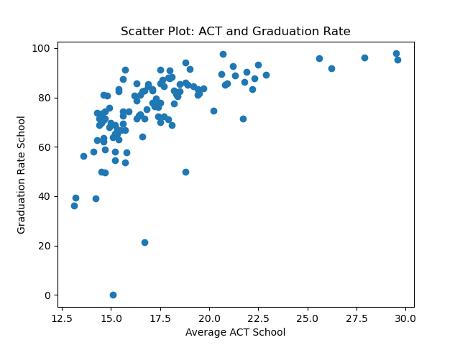
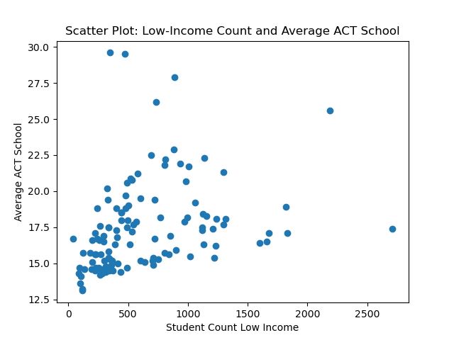
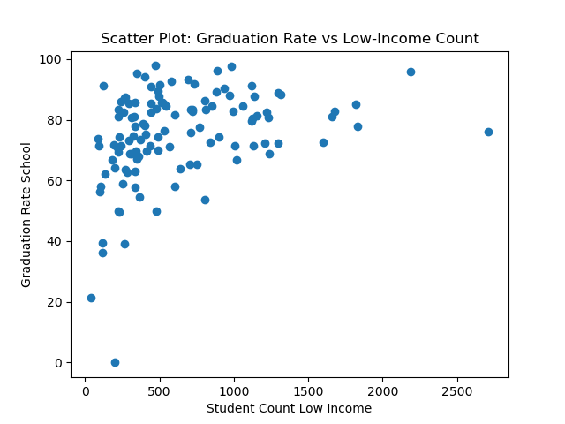
Exploratory Analysis
(Completed using python)
Correlation between Average ACT and Graduation Rate: 0.59
Correlation between Average ACT and Student Count Low Income: 0.31
Correlation between Graduation Rate and Student Count Low Income: 0.34
Positive correlation
Weak positive correlation
Weak positive correlation

Slide 8
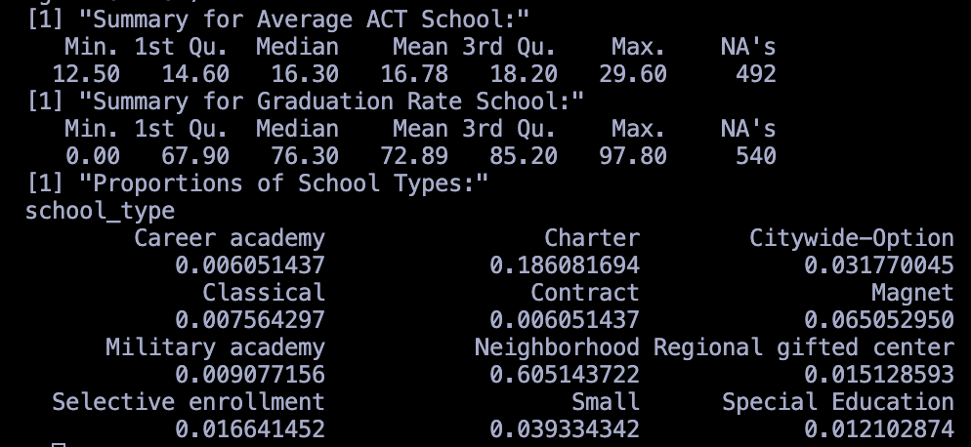
Descriptive Analysis (Completed using R)
Note max/mins, medians, and means.
Min of 0% was from PATHWAYS - ASHBURN HS
Possibly due to lack of data, error, or something else.
50% of average ACT scores are between 14.6 to 18.20
50% of graduation rates are between 67.9% and 85.2%
Standard Deviation for Average ACT School: 3.069603
Standard Deviation for Graduation Rate School: 19.36454
---------------------------------------------------
Observing the frequency table, we see that most schools in Chicago Public School district are Neighborhood schools.
The second most frequent school type are charter schools.

Slide 9
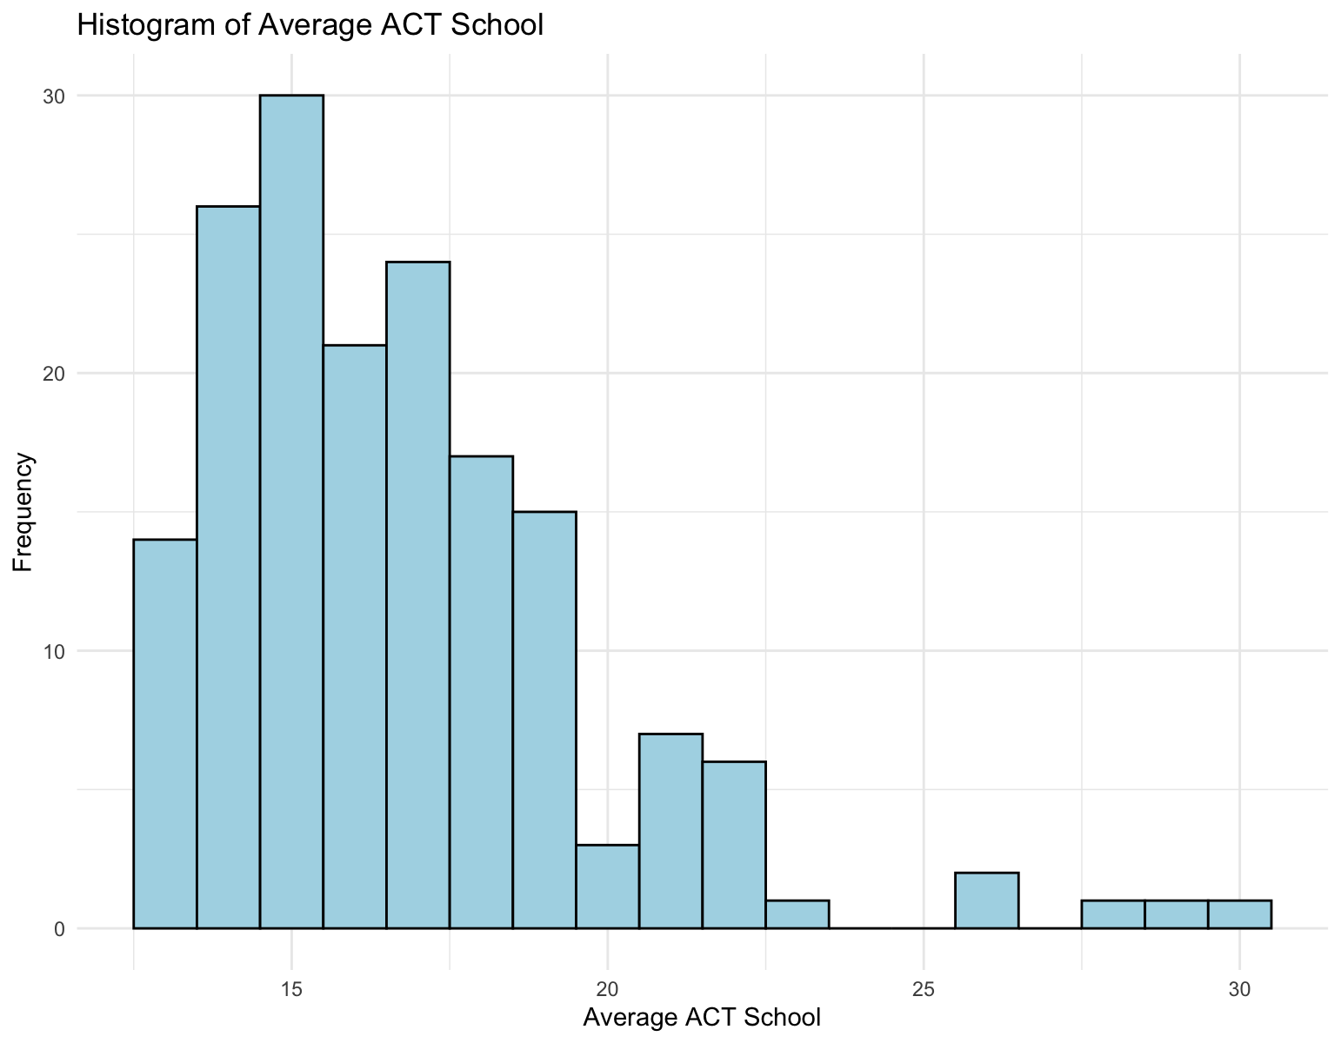
Data Visualizations (1/3)
Normal & Positive Skew

Slide 10
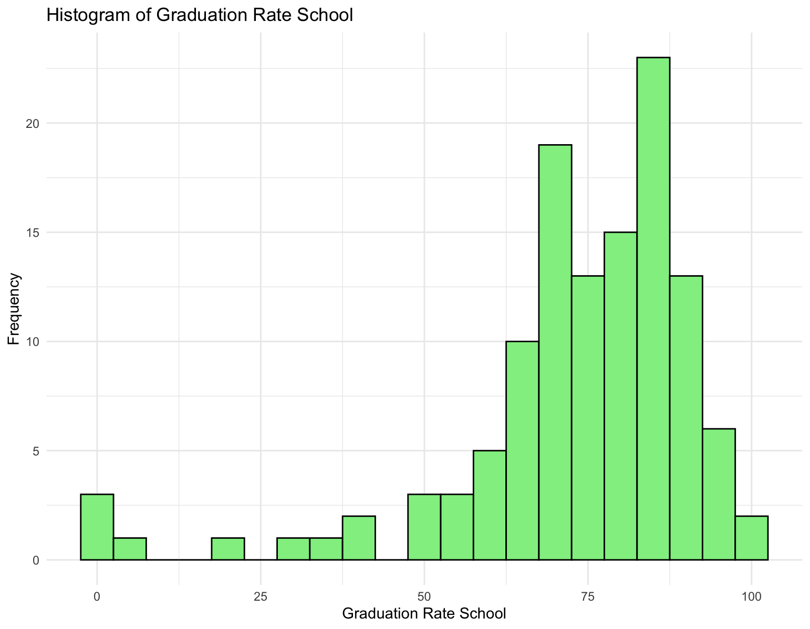
Data Visualizations (2/3)
Normal & Negative Skew

Slide 11
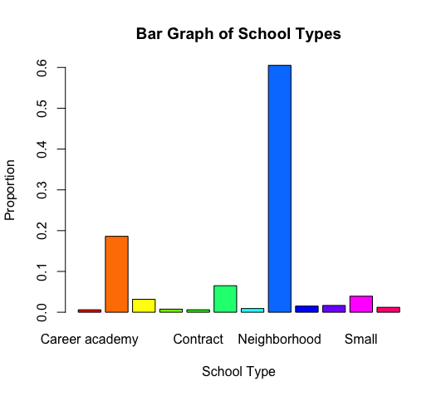
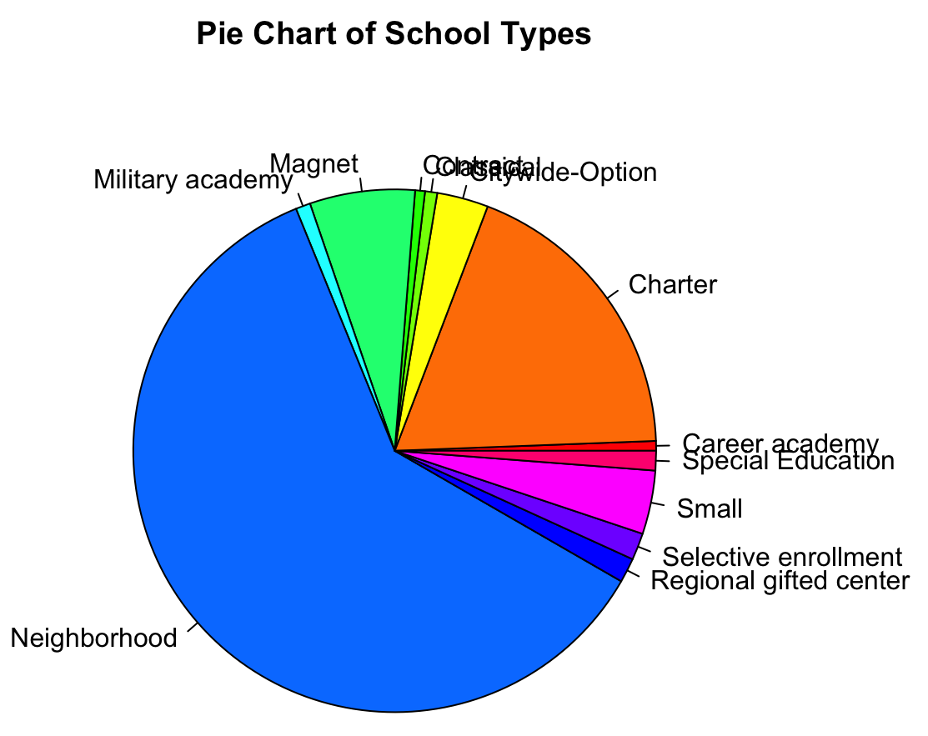
Data Visualizations (3/3)
Neighborhood Majority

Slide 12
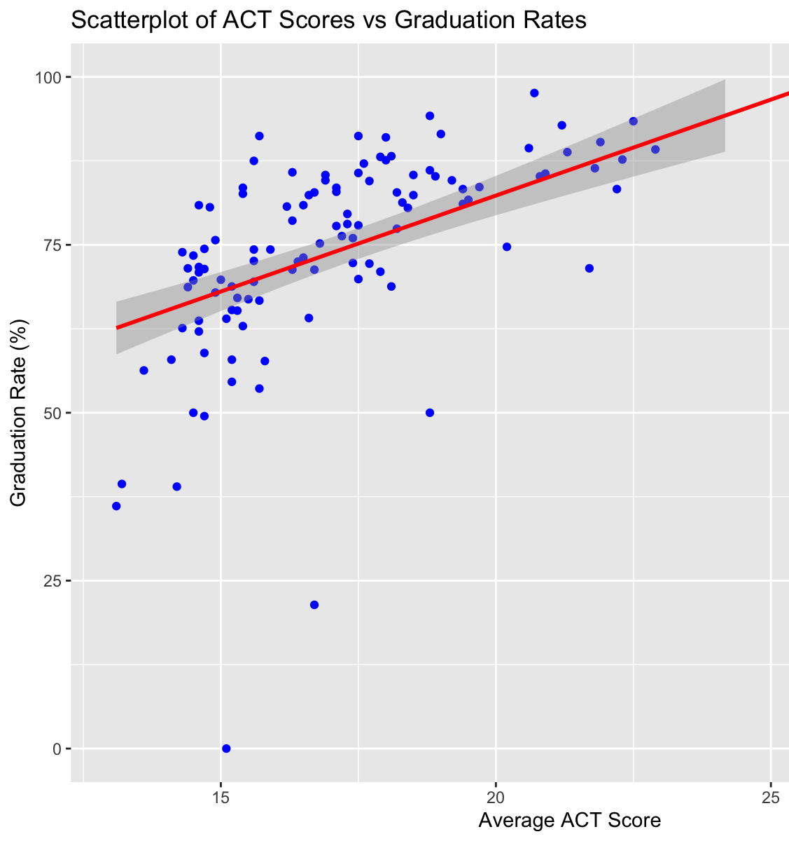
Mechanistic Analytics (1/2)
(Completed in R)
The mechanistic analysis explored the relationship between Average_ACT_School as the predictor (X) and Graduation_Rate_School as the outcome (Y). The scatter plot with a regression line indicated a positive linear relationship, suggesting that schools with higher ACT averages tend to achieve higher graduation rates.
As Chicago schools’ average ACT scores increase by one point, we predict average graduation rate to increase by roughly 2.86%.
Equation: Y = 25.17 + 2.86X
Y(0) = 25.17 is an extrapolated prediction.
The line starts around 55–60 because the data begins at higher ACT scores.

Slide 13
Mechanistic Analytics (2/2)
(Completed in R)
Task: If a random high school in Chicago public school district has an average ACT score of 22, what is the schools predicted graduation rate?
Answer: Predicted graduation rate for a school with an average act score of 22: 88.05%

Slide 14

Conclusions
Q: Is there a relationship between a low-income lifestyle and academic performance in Chicago schools?
Ans: The correlation analysis indicates a weak positive relationship between the proportion of low-income students at a school and its graduation rate or ACT performance. However, this relationship is not strong enough to draw definitive conclusions
Academic outcomes in Chicago schools are likely influenced by a combination of factors beyond income, such as access to resources, teacher quality, and community support.
Q. What kind of schools populate the district of Chicago?
Ans: Most schools in the district of Chicago are neighborhood schools.
New Findings:
Graduation rate positively correlates with ACT scores, reinforcing that academic achievement is closely linked to graduation outcomes.
This data is relatively common knowledge, but should influence school leadership and parents to prioritize ACT prep, focus on college readiness skills, promote ACT awareness, etc.

